Slide 1
University Admission prediction
ML group C8

Slide 2
Description
We aim to develop a system that predicts admission outcomes for prospective students when they apply to our educational institution. The system should assess applicants based on their academic history, extracurricular activities, and other relevant factors, providing personalized insights into their likelihood of acceptance.

Slide 3
Task
Experience
Performance
Task (T): Predict admission outcomes for applicants based on their academic history, extracurricular activities, and other relevant factors.
Experience (E): Historical data on past admissions, including academic records, extracurricular involvement, and acceptance decisions.
Performance (P): Accuracy of admission predictions, measured by how well the system forecasts acceptance outcomes aligned with the
Notes:
The goal is to create a machine learning-based Admission Prediction System for an educational institution. The system should learn from historical admission data (Experience E) to predict admission outcomes (Task T). The performance measure (P) would be the accuracy of the predictions, ensuring alignment with the institution's admission criteria. Assumptions include the availability of relevant historical admission data and the assumption that admission criteria will remain consistent within the learning period. Additionally, the system assumes that applicants might not have provided a complete overview of their qualifications

Slide 4
Assumptions
Applicant Profile Stability: Assumes that applicants' academic history and extracurricular activities will remain relatively stable during the learning period.
Relevant Historical Admission Data: Assumes the availability of sufficient and relevant historical data to train the prediction system effectively.
Incomplete Applicant Information: Assumes that applicants might not provide a complete overview of their qualifications, and the system can make accurate predictions based on partial data.
Applicant Engagement: Assumes that applicants will appreciate and engage with admission predictions without finding them intrusive or discouraging
Notes:
Incomplete applicant information: assumes that applicants may not provide a complete overview of their qualifications and the system may make accurate predictions based on partial data . Applicant Engagement: Assumes that applicants value and engage with admissions predictions without making them feel intrusive or discouraging.

Slide 5
Introduction
Motivation: The primary motivation for solving the Admission Prediction System for an educational institution is to streamline the admissions process and provide valuable insights to both applicants and the institution
Benefits of Solution: Applicants will gain valuable insights into their likelihood of acceptance, enabling them to make informed decisions and potentially improve their profiles, e institution's perspective, the system can optimize the admissions process, ensuring a more efficient and data-driven selection of candidates
Solution Use: The solution will be integrated into the educational institution's admission process, operating in real time to offer predictions based on applicant profiles and relevant factors, The ultimate goal is to create a dynamic and self-improving system that becomes an integral part of the admissions process
Notes:
By providing personalized predictions based on academic performance and extracurricular activities, our goal is to improve the application experience and increase understanding of admissions. Applicants will receive valuable information about their grades, which will help them make decisions and improve their reputation. The main benefits are candidate satisfaction, increased productivity and academic competitiveness. Application of the Response System: Response is integrated into the school's admissions process and instantly provides predictions based on the applicant's history and requirements.

Slide 6
Dataset 1
About: The data appears to be related to graduate admissions, possibly for master's or doctoral programs. The columns suggest various attributes that might be considered during the admission process, such as GRE score, TOEFL score, university rating, SOP, LOR, CGPA and whether the applicant has research experience. The target variable seems to be 'Chance of Admit,' indicating the likelihood of admission.
Features: Serial number, GRE score, TOEFL score, University rating, SOP, LOR, CGPA, Research, Chance of Admit
Importance of Features: GRE and TOEFL scores, CGPA, and research experience are likely crucial factors in the admission process, reflecting academic proficiency and research background. SOP and LOR might provide insights into the applicant's motivations and character, influencing the decision. University Rating could be a proxy for the reputation of the applicant's undergraduate institution

Slide 7
Dataset 2
About: The dataset seems to be related to individuals and their academic details, potentially for admission purposes. The columns include information such as name, age, date of birth (dob), nationality, gender, mother tongue, academic scores, entrance rank, SAT scores, and admission status.
Features: id, name, age, DOB, nationality, gender, mother_tongue, 10th_score, 12th_score, main_score, entrance_rank, sat_score, Admission_Status
Applications: The dataset appears to be relevant for educational institutions or organizations involved in the admission process. It could be used for predicting admission outcomes based on various factors like academic scores, entrance ranks, and SAT scores. Educational research focused on the correlation between academic performance and admission status could leverage this dataset. It might be used for creating models to understand the factors influencing admission decisions.

Slide 8
Dataset 3
About: This dataset revolves around the admission process in a university, focusing on aspects like gender, admission fee, preferred branch, loan requirements, campus preferences, entrance exam ranks, and the final admission acceptance status. It essentially captures the details of students applying for admission and the factors influencing their admission outcomes.
Features: Admission_id, fee_range, fee_range, fee_slab, req_branch, allotted_branch, campus_req, campus_allotted, entrance_rank, admission_acceptance
Importance of Features: Utilized to develop predictive models to forecast admission outcomes based on historical data, Assisting in planning for the allocation of resources, including faculty and infrastructure, based on branch preferences, Analyzing the distribution of fee ranges and loan applications to understand the financial dynamics of the student population, Exploring gender-based trends to enhance diversity and inclusion initiatives within the university

Slide 9
Dataset 4
About: This dataset revolves around the admission process for the Indian Institutes of Technology (IITs). It encompasses various factors that are considered during the admission procedure.
Features: Year, 10th marks, 12th marks, 12th divison, AIEEE rank, collage
Applications: Developing models to predict the likelihood of admission based on historical data, helping prospective students understand their chances, Analyzing trends over the years to assess the impact of changes in admission criteria or educational policies, Studying the correlation between different academic factors (10th marks, 12th marks, AIEEE rank) and success in IIT admissions.

Slide 10
Gradient Boosting Algorithm
The powerful Gradient Boosting Algorithm is employed to elevate the accuracy and efficiency of an Admission Prediction System in the educational domain. Using decision trees as base learners, the algorithm sequentially corrects prediction errors, constructing a robust model for forecasting admission outcomes. By considering applicant profiles, academic history, extracurricular activities, and other relevant factors, the Gradient Boosting Algorithm offers precise and personalized predictions. This contributes to an informed decision-making process for both applicants and the educational institution, ultimately improving transparency and optimizing the admissions process.

Slide 11
Naïve Bayes
The Naive Bayes algorithm, known for its simplicity and efficiency, is leveraged to address the Admission Prediction System for educational institutions. Utilizing probabilistic models, Naïve Bayes classifies applicants based on their profiles and historical admission outcomes. By modeling dependencies between applicant qualifications and admission criteria, the algorithm calculates the likelihood of an applicant being accepted, enabling effective personalized predictions. The Naïve Bayes approach offers a lightweight yet effective solution for improving the transparency and efficiency of the admissions process in educational institutions.

Slide 12
Support Vector Machine(SVM)
The robust Support Vector Machine (SVM) algorithm is applied to optimize the Admission Prediction System in an educational environment. By transforming applicant profiles and academic data into a high-dimensional space, SVM constructs hyperplanes that separate and classify applicants based on their likelihood of acceptance. The algorithm excels in capturing intricate patterns and nonlinear relationships, ensuring accurate predictions for admission outcomes. SVM's ability to handle complex datasets makes it a valuable asset for improving the precision and personalization of admission predictions, contributing to enhanced transparency and satisfaction for both applicants and the educational institution.

Slide 13
Neural Networks
Neural networks for admission data mimic human decision-making. They learn patterns from past admission records, analyzing factors like grades and test scores. Input data, resembling a student's profile, undergoes layers of interconnected nodes, adjusting weights to optimize predictions. This mirrors how humans evaluate applicants, identifying key features for acceptance. The model refines its understanding through iterative training, adapting its internal parameters to improve accuracy. By emulating human-like cognition, neural networks discern complex patterns, enhancing their ability to classify applicants effectively based on historical data, making them powerful tools for automating admission decisions

Slide 14
For Dataset 1

Slide 15
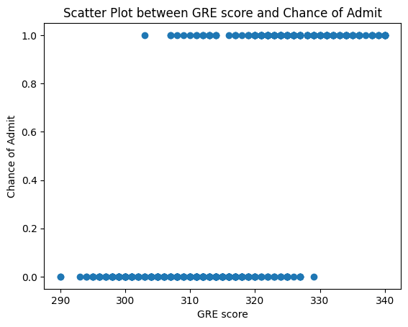
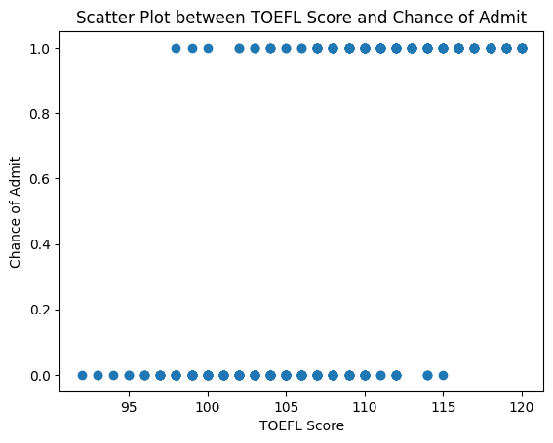
Some visualizations between target and attributes

Slide 16
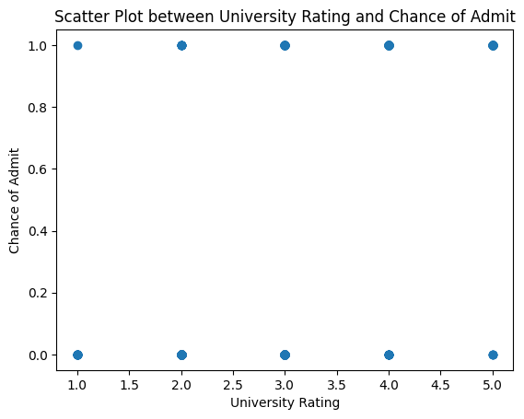
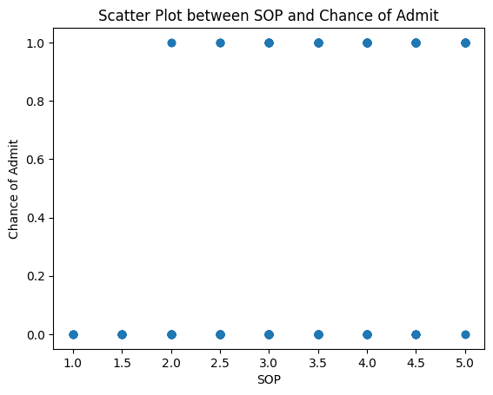
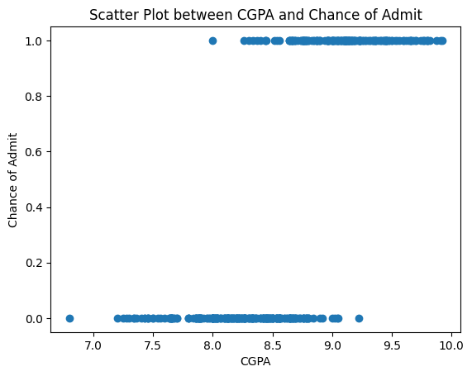

Slide 17
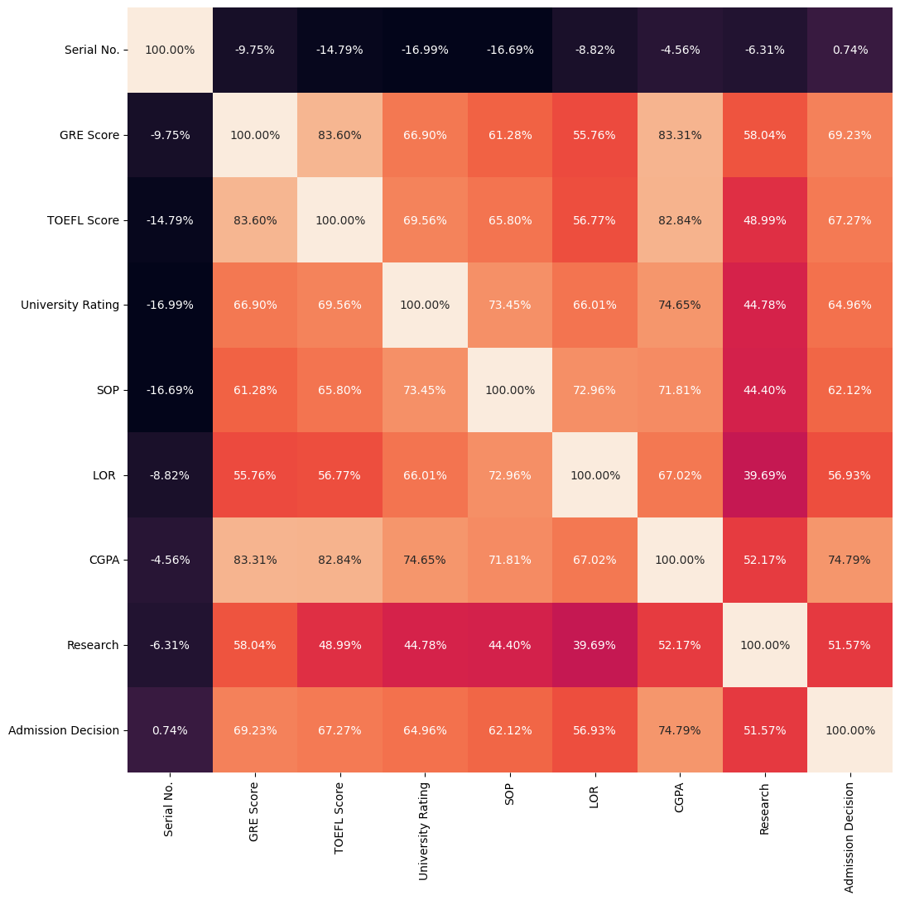
Heatmap

Slide 18
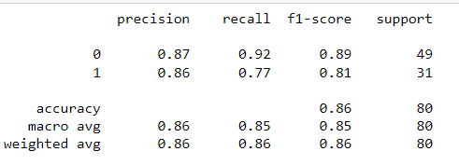
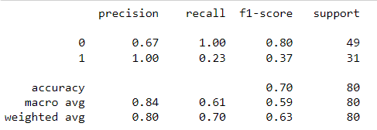
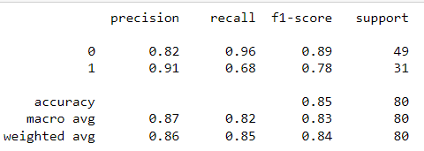
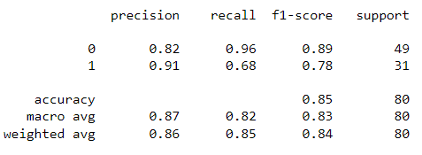
Classification reports
Gradient Boost classifier
SVC
Naïve Bayes
Neural Networks

Slide 19
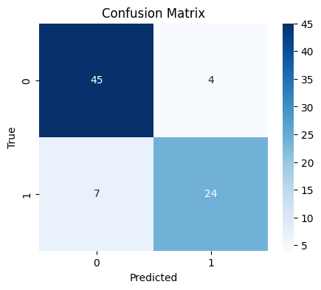
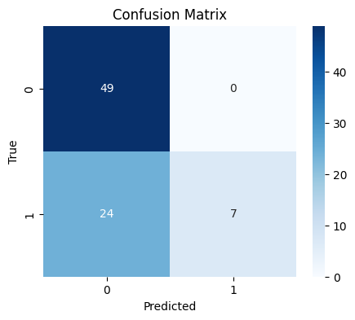
Confusion matrices
Gradient Boost
SVC

Slide 20
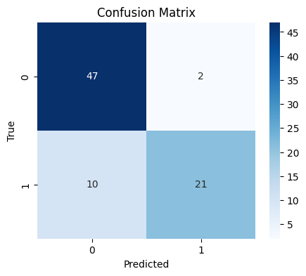
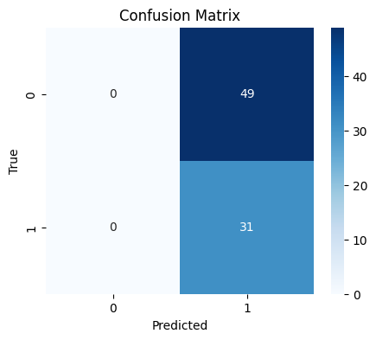
Naïve Bayes
Neural Networks

Slide 21
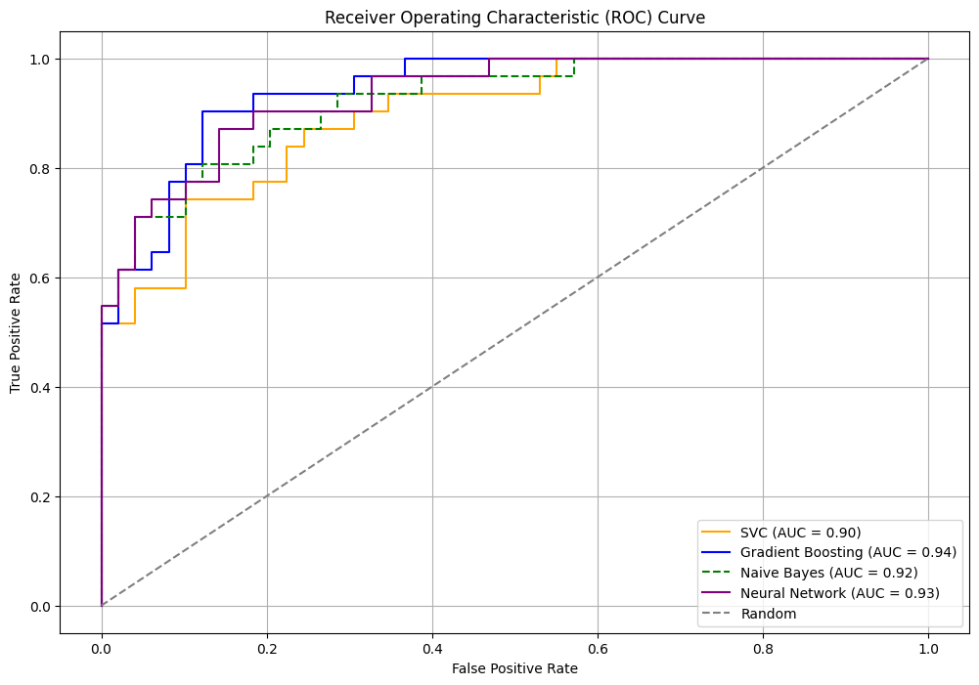
ROC curve
By observing the ROC curve we can understand that for the dataset 1 the SVC algorithm is working best as the area under the curve is more for the SVC algorithm

Slide 22
For Dataset 2

Slide 23
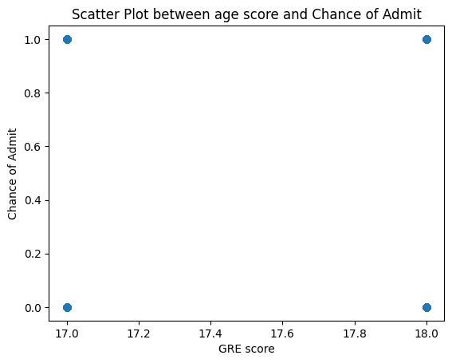
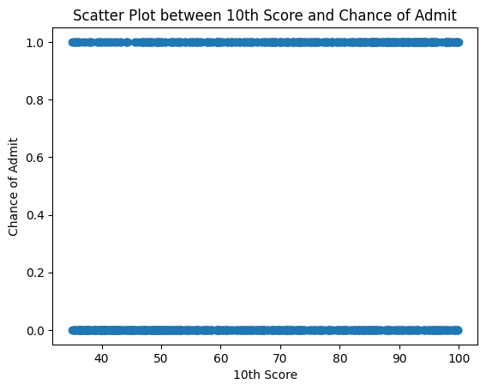
Some visualizations between target and attributes

Slide 24

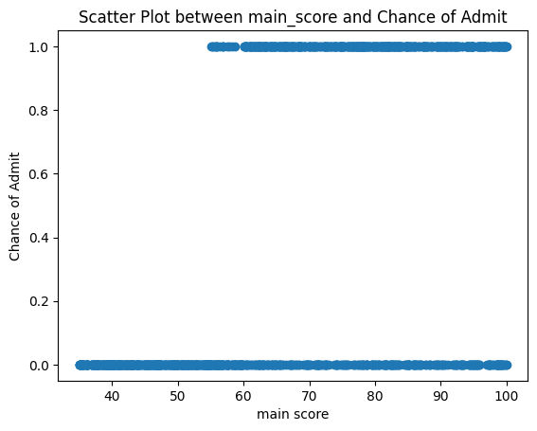
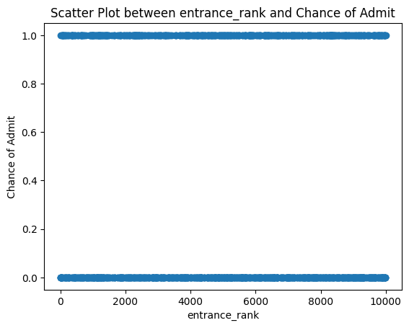
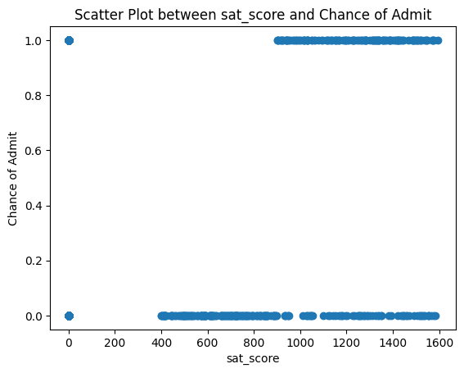

Slide 25
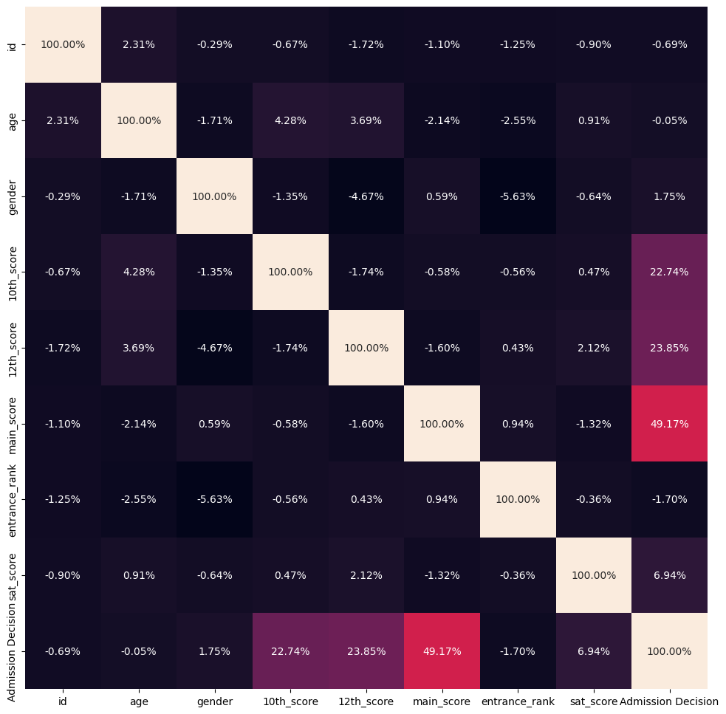
Heatmap

Slide 26
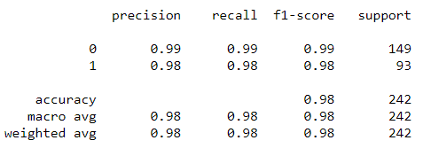
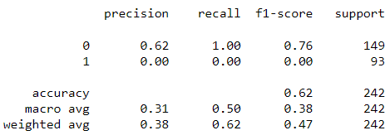
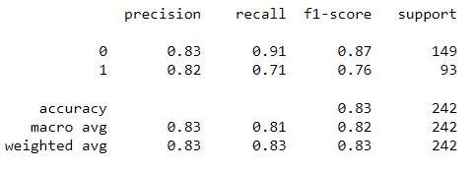
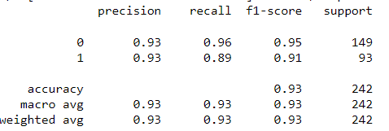
Classification reports
Gradient Boost classifier
SVC
Naïve Bayes
Neural Networks

Slide 27
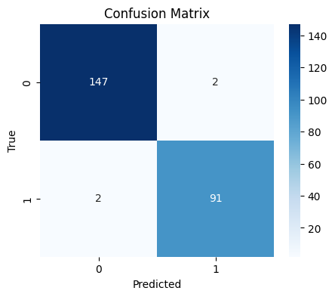
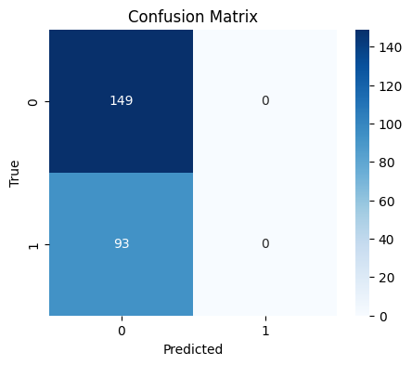
Confusion matrices
Gradient Boost
SVC

Slide 28

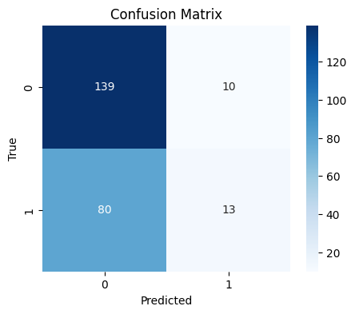
Naïve Bayes
Neural Networks

Slide 29
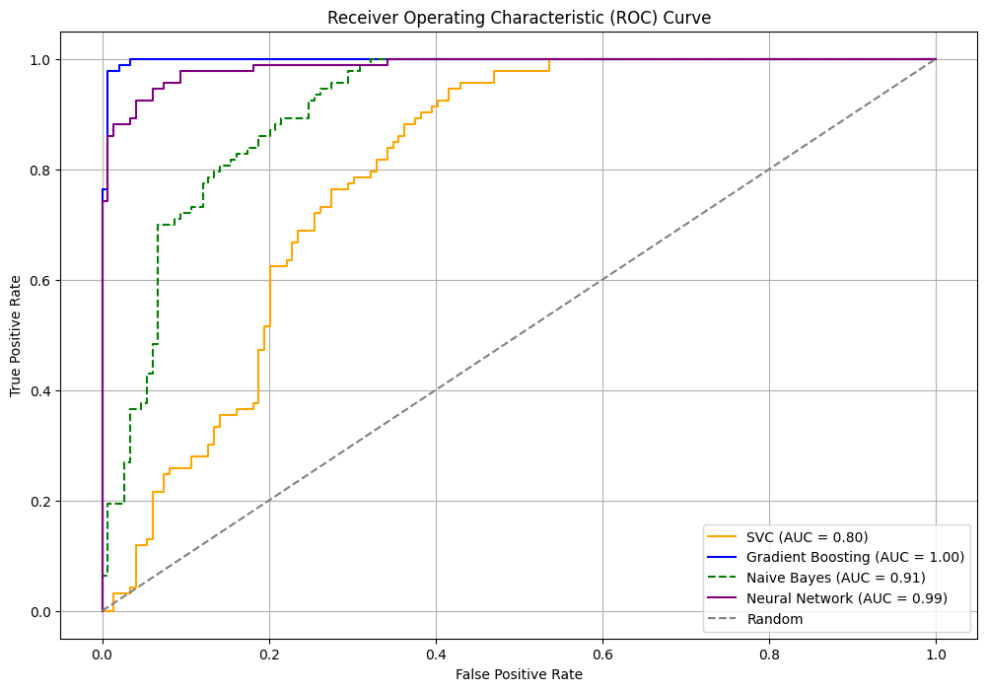
ROC curve
By observing the ROC curve we can understand that for the dataset 2 the Gradient Boosting algorithm is working best as the area under the curve is more for the Gradient Boosting algorithm

Slide 30
For Dataset 3

Slide 31
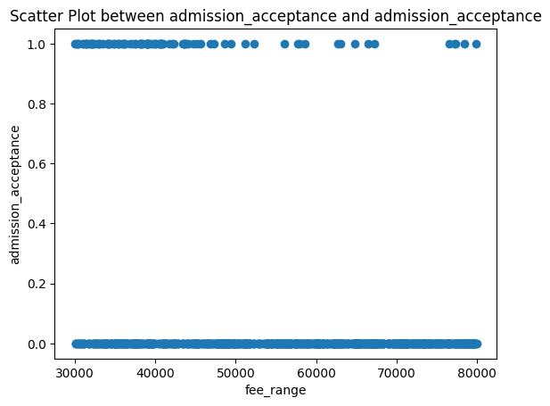
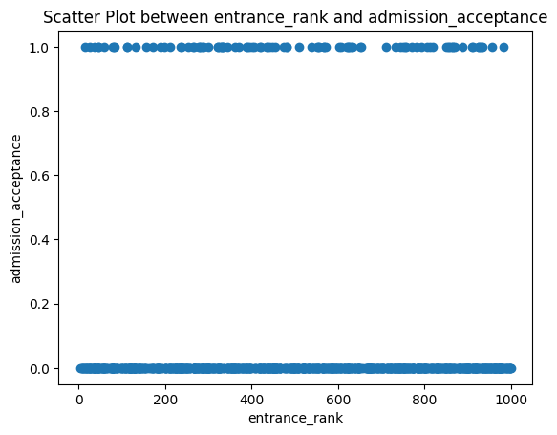
Some visualizations between target and attributes

Slide 32
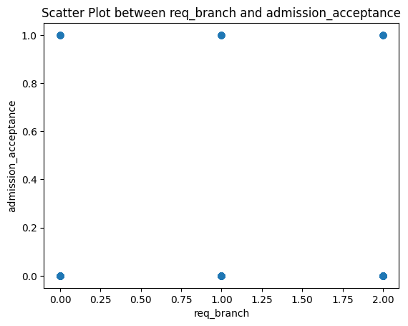

Slide 33
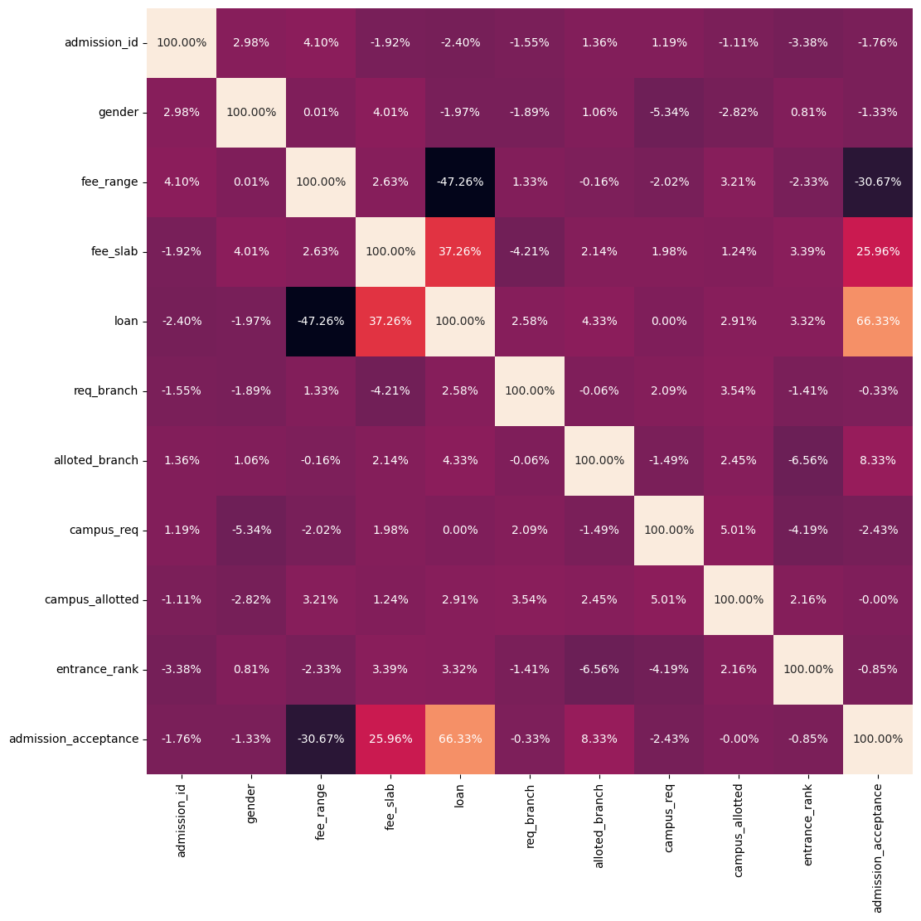
Heatmap

Slide 34
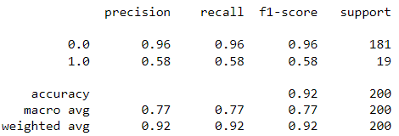
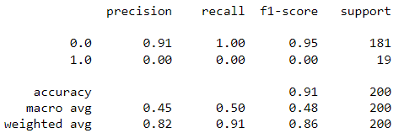
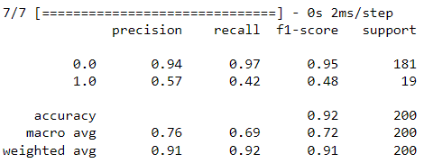
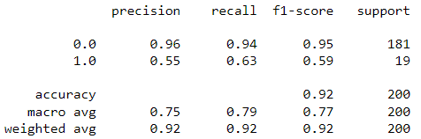
Classification reports
Gradient Boost classifier
SVC
Naïve Bayes
Neural Networks

Slide 35
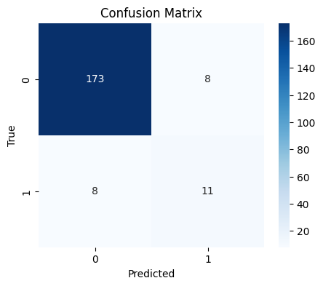

Confusion matrices
Gradient Boost
SVC

Slide 36
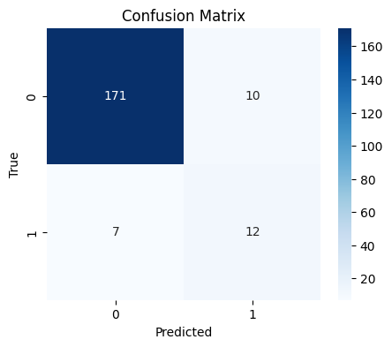
Naïve Bayes
Neural Networks

Slide 37
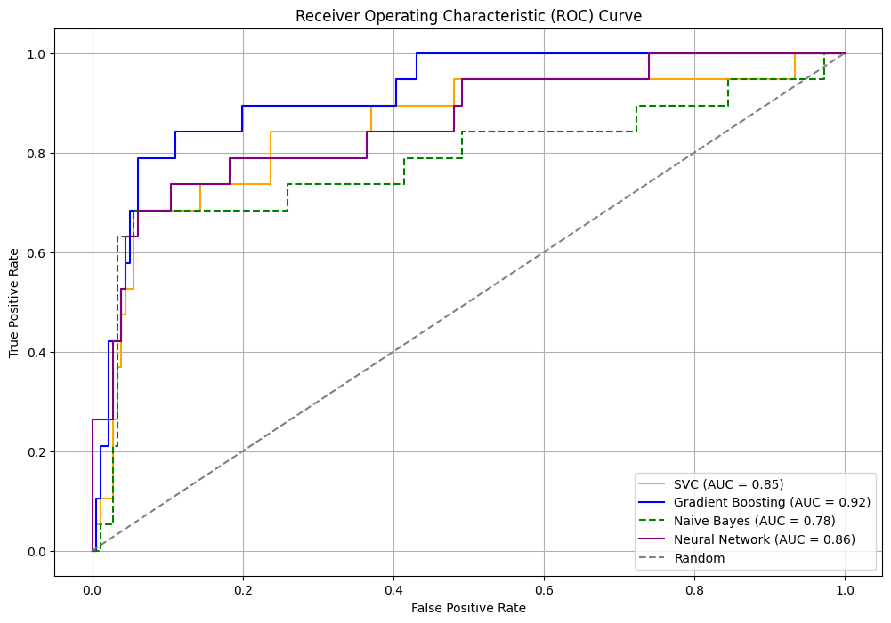
ROC curve
By observing the ROC curve we can understand that for the dataset 2 the Gradient Boosting algorithm is working best as the area under the curve is more for the Gradient Boosting algorithm

Slide 38
For Dataset 4

Slide 39
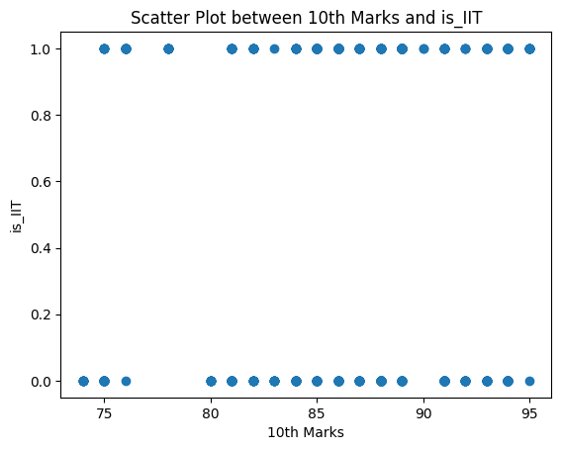
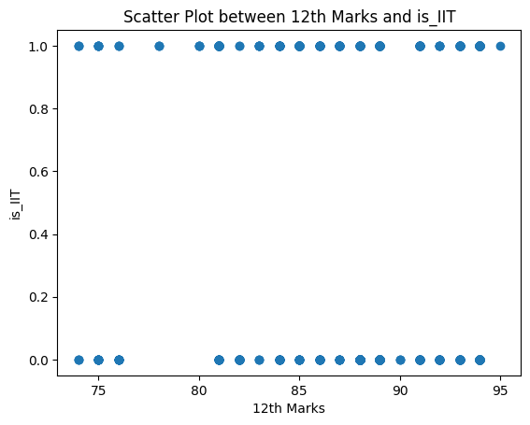
Some visualizations between target and attributes

Slide 40
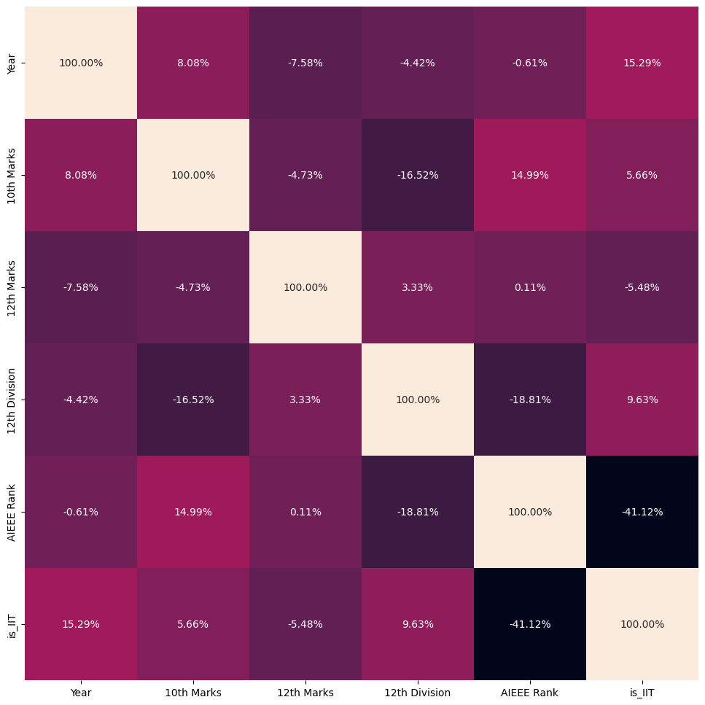
Heatmap

Slide 41
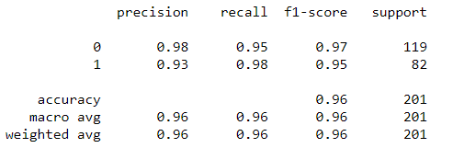
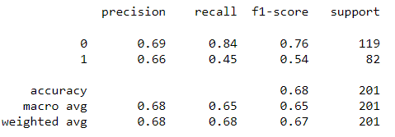
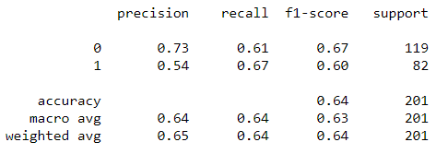
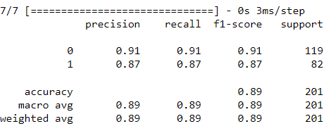
Classification reports
Gradient Boost classifier
SVC
Naïve Bayes
Neural Networks

Slide 42
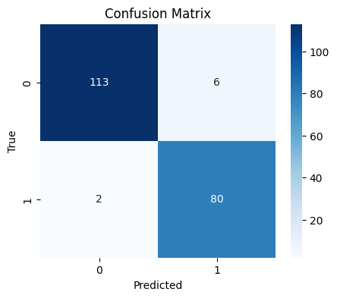
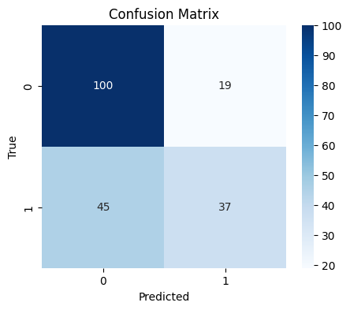
Confusion matrices
Gradient Boost
SVC

Slide 43
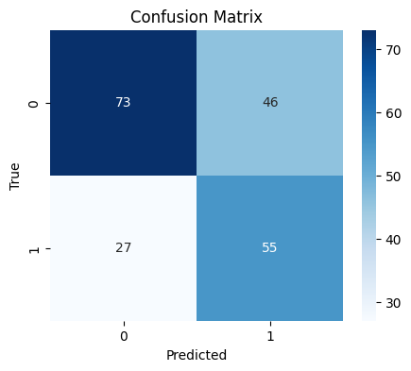

Naïve Bayes
Neural Networks

Slide 44

ROC curve
By observing the ROC curve we can understand that for the dataset 2 the Gradient Boosting algorithm is working best as the area under the curve is more for the Gradient Boosting algorithm

Slide 45
Thank you

